Slide 2
…or perhaps it was a Tweet? Snapchat? Telegram? Viber? Or What’s App? Whatever it is…It’s definitely something I want to share with you… IT’S REVELATORY

Slide 3
Prerequisite to receiving the Torah (Personal and National)
Unity of the Nation
(“We will listen, We will do…” Ex. 24:7)
Good Character
(Ethics of our Fathers 6:6)
Diligence “ They journeyed from Rephidim.” Ex. 19:2
Refah- weakness
Humility “a person makes himself like a wilderness” Ex. 19:2

Slide 4
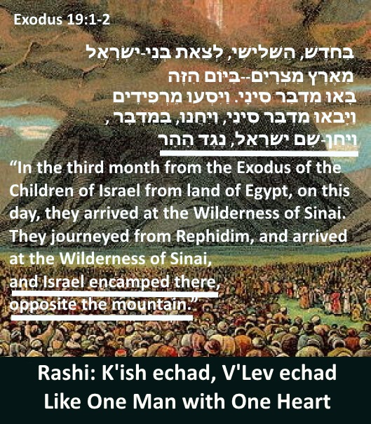

Slide 5
Why is Am Yisrael collectively called by the name Yehudim/Jews today?
Leah named her 4th child “Yehuda/Thank you” which represents a character trait that all of AM YISRAEL should adopt – TO BE GRATEFUL – especially for receiving good beyond expectations. (Gen 29:35) also means to acknowledge.
The largest tribe of the House of Jacob being “Judah” were not entirely lost through the exile of Assyria (Sancherev).
Before the Assyrian onslaught – many remnants from the northern 10 tribes sought refuge in the Kingdom of Yehuda – (see II Chronicles 30:11-12 “However, some people from Asher, Menasheh and Zebulen humbled themselves and came to Jerusalem. Also in Yehuda the hand of God was upon them, instilling them all with a united heart to follow the commandment of the king and the leaders regarding the word of Hashem.”

Slide 6
We see that those who remained loyal to King of Yehuda (Davidic Dynasty) and managed to flee to the south, were absorbed into the Largest Tribe (Judah) whose area already included Benjamin, Shimon, many Levites and Cohanim - so today those who were committed to and remain loyal to the Davidic Dynasty are called Yehudim/Jews.

Slide 7
Additional verses describing the term Yehudim as the
COLLECTIVE for THE NATION OF ISRAEL
See Gen 49:8-10 “Judah – you, your brothers shall acknowledge, …your fathers sons will prostrate themselves toward you…and his will be an assemblage of nations”
See Esther 2:5 “There was a Jewish man in Shushan, a Benjaminite…”
See Isaiah 36:11 The Hebrew language here is referred to as JEWISH (Yehudit)
II Chron. 34 The entire chapter describes the remnant of Menasha and Ephriam recommitted to the Torah and to the King of Yehuda.

Slide 8
The Last Prophecy – Malachi 3:22-24
“Remember the Torah of Moses My servant, which I commanded him at Horeb for all Israel – its decrees and its statutes. Behold, I send you Eliyahu the prophet before the coming of the great and awesome day of Hashem. And He will turn back to God the hearts of the fathers with their sons and the hearts of the sons with their fathers, lest I come and strike the land with utter destruction.”
זִכְרוּ, תּוֹרַת מֹשֶׁה עַבְדִּי, אֲשֶׁר צִוִּיתִי אוֹתוֹ בְחֹרֵב עַל-כָּל-יִשְׂרָאֵל, חֻקִּים וּמִשְׁפָּטִים.
הִנֵּה אָנֹכִי שֹׁלֵחַ לָכֶם, אֵת אֵלִיָּה הַנָּבִיא--לִפְנֵי, בּוֹא יוֹם יְהוָה, הַגָּדוֹל, וְהַנּוֹרָא.
וְהֵשִׁיב לֵב-אָבוֹת עַל-בָּנִים, וְלֵב בָּנִים עַל-אֲבוֹתָם--פֶּן-אָבוֹא, וְהִכֵּיתִי אֶת-הָאָרֶץ חֵרֶם.

Slide 9
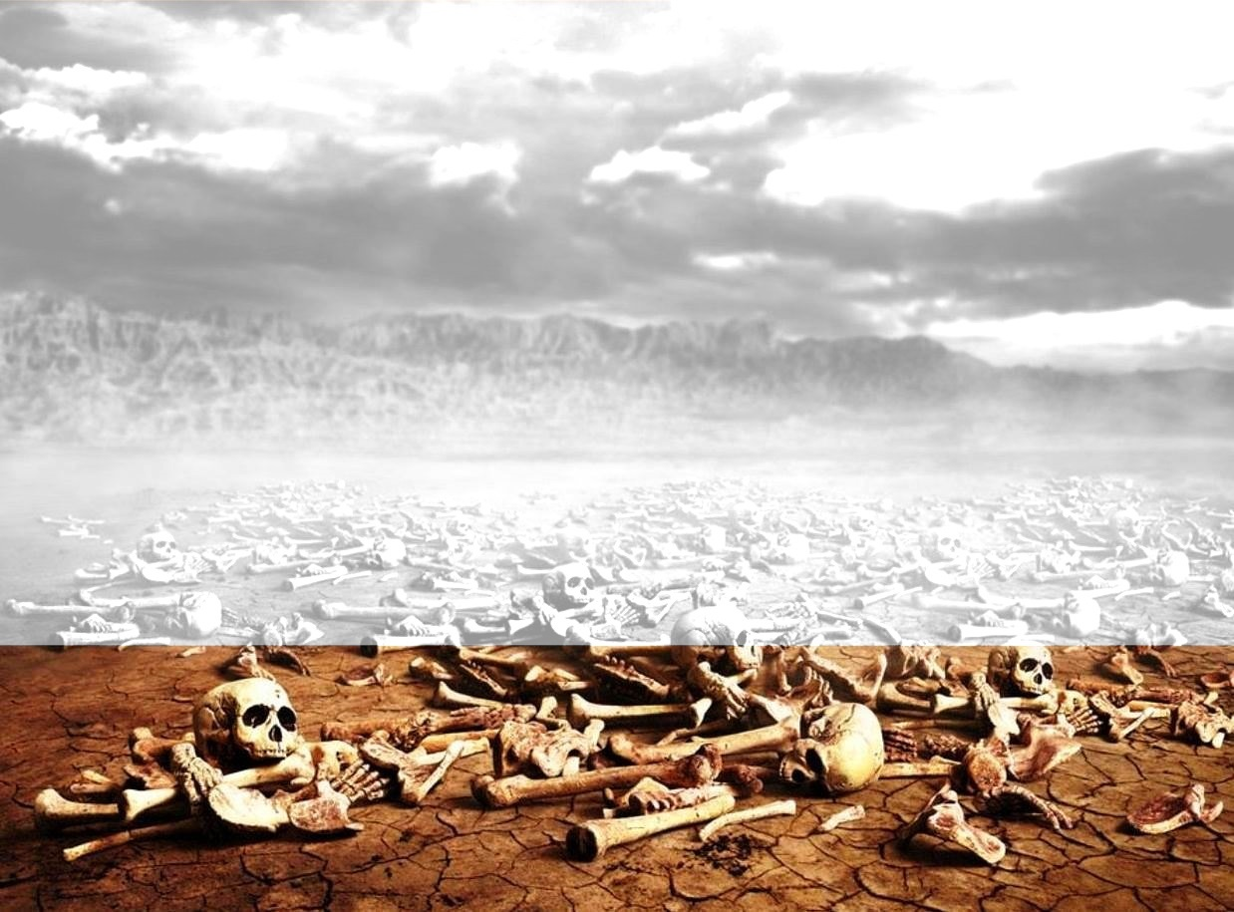
DRY BONES – EZEKIEL 37:21-22
²¹ … ‘This is what the Sovereign Lord says: I will take the Israelites out of the nations where they have gone. I will gather them from all around and bring them back into their own land.
²² I will make them into one nation in the land, upon the mountains of Israel, and one king will be king for them all; they will no longer be two nations, and they will no longer be divided into two kingoms, ever again.”
24…My servant David will be king over them, and there will be one shepherd for all of them; they will follow My ordinances and keep My decrees to fulfill them.”

Slide 10
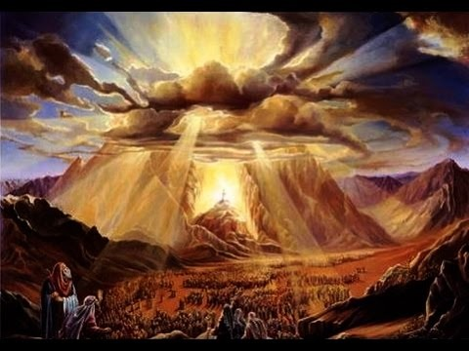
Exodus 24:12
And Hashem said to Moses: ‘Ascend to Me to the mountain and remain there, and I shall give you the stone Tablets and the Teaching and the Commandment, that I have written, to teach them.'
וַיֹּאמֶר יְהוָה אֶל-מֹשֶׁה, עֲלֵה אֵלַי הָהָרָה--וֶהְיֵה-שָׁם; וְאֶתְּנָה לְךָ אֶת-לֻחֹת הָאֶבֶן, וְהַתּוֹרָה וְהַמִּצְוָה, אֲשֶׁר כָּתַבְתִּי, לְהוֹרֹתָם.
Keep in mind we are referring to the 50th day after leaving Egypt. The first Shavuot!
Moses remained there for 40 days.

Slide 11
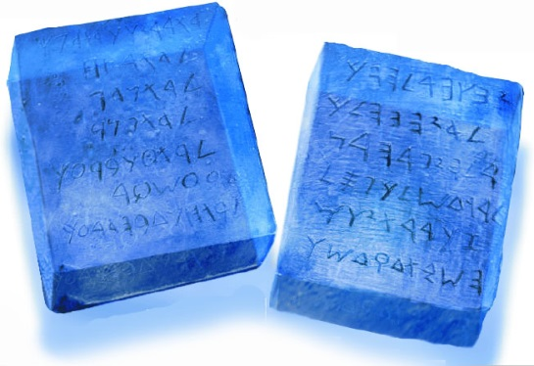
Is this verse clear? This is what Moshe received…
The Stone Tablets אֶת-לֻחֹת הָאֶבֶן
And the Torah והַתּוֹרָה
And the Mitzvah (commandment) והַמִּצְוָה
All (or at least one of them) was written down
אֲשֶׁר כָּתַבְתִּי
These were given to Moshe Rebbeinu (Peace be upon him) To Teach them, as an instruction manual with clear definitions regarding everything that was written in it
לְהוֹרֹתָם
This verse cannot only be speaking about the 10 Utterances, nor only to the written Torah.
Within the written Torah there are many mitzvot that lack explanation. For example, Teffilin (Totofot) – what are they? The fruit of a beautiful tree (Pri Eitz Hadar), How does one slaughter an animal (Shechita), Which actions are included among the forbidden actions on Shabbat (Isur Melacha) especially considering the fact that the punishment for desecration of the Shabbat is the death penalty (Capital Crime)

Slide 12
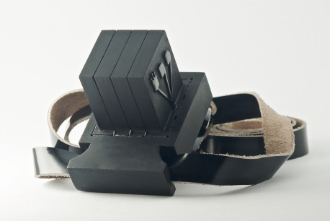
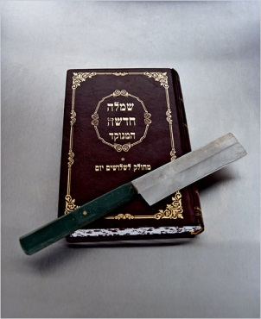
Within the written Torah there are many mitzvot that certainly lack explanation.
For example, Teffilin (Totofot) –
what are they?
The fruit of a beautiful tree (Pri Eitz Hadar),
How does one slaughter an animal (Shechita),
Which actions are forbidden on Shabbat
(Isur Melacha) especially considering the fact
that the punishment for desecration of the
Shabbat is the death penalty (Capital Crime)

Slide 13
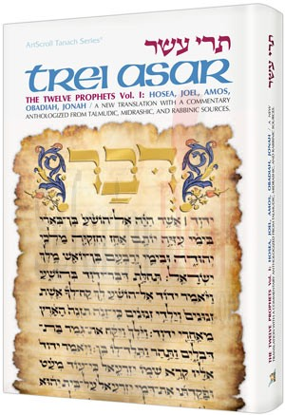
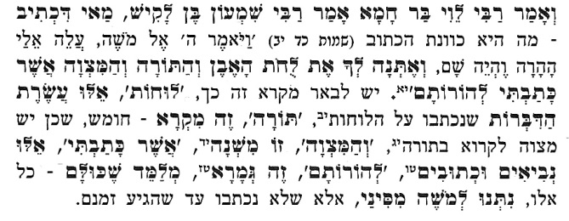
Tractate Brochot 5a
Rebbi Levi bar Chama said in the name of Rabbi Shimon Ben Lakish: “…and I shall give you the stone Tablets and the Teaching and the Commandment, that I have written, to teach them.‘
“Luchot” – (tablets) refers to the 10 Utterances
“Torah” - this is the 5 books (Mikrah) because it is a mitzvah to read in public
“Mitzvah” - this is the Mishneh (the basis for the oral law which contains the details of the commandments.
“Asher Ketavti” - (which I have written) refers to the Prophets and the Writings
“Le’Horotam” – (to teach them) refers to the Gemorah (Talmud)
THIS TEACHES THAT ALL OF THEM WERE GIVEN TO MOSES AS MT. SINAI
(but were not written down until the proper time arrived)

Slide 14
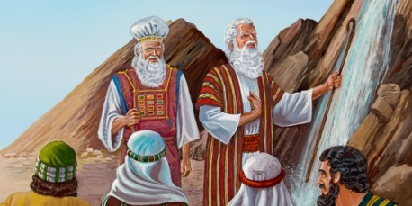
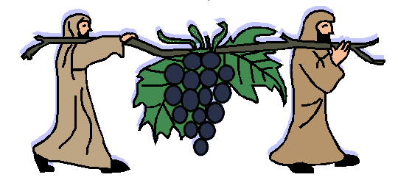
This Gemorah expounds from this verse that it was the entire complete Torah, including the Oral Torah that was given at Mt. Sinai! Can this be true? Is this possible? The Gemorah says that the Written Torah along with the Prophets were actually given to Moshe Rebbeinu (on that day).
If that were true, Moshe would certainly would have known about the Transgression at the Waters of Strife,
would he then have hit the rock knowing the
consequences?
Would Moshe ever have sent the spies knowing
the result would be not entering the land
for 39 more years?
We must conclude that Moshe received all the fundamental principals of the Torah and the Prophets, but not the exact wording of the Torah (during these 40 days)!

Slide 15
All 613 commandments are included within the 10 Utterances. Rebbeinu Sadia Goan in his commentary lays the foundation for each and every statement and which (of the 613) mitzvot are dependent on that Utterance.
The Medrash Rabba states that since there are 620 letters in the 10 Utterances – each letter corresponding to a mitzvah. The other 7 letters refer to the 7 days of creation to teach you that the entire world was created for the sake of Torah.
At this point we are forced to explain the verse: Hashem will literally give the Tables of Stone. The Torah and Mitzvot are included in the 10 Utterances which were written on the Tablets, in order to teach them.

Slide 16
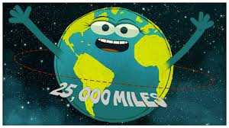
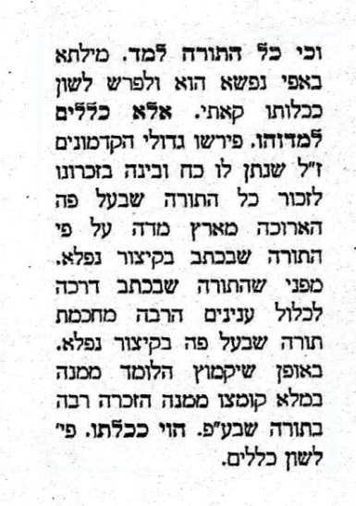
Midrash Rabba (Shmot 41)
Did Moshe Rebbeinu really learn the whole Torah (in only 40 days)?
It is written about the Torah (Job 11:9)
“It’s measure is longer than the earth, and
broader than the sea” אֲרֻכָּה מֵאֶרֶץ מִדָּהּ; וּרְחָבָה, מִנִּי-יָם
and Moshe learned the whole Torah in only 40 days”?
It was the principals that Hashem taught Moshe, as the language portrays (Exodus 31:18) “He gave to Moses, when He finished speaking with him on Mt. Sinai, the Two tablets of Testimony , stone tables, by the finger of God.
ַויִּתֵּן אֶל-מֹשֶׁה, כְּכַלֹּתוֹ לְדַבֵּר אִתּוֹ בְּהַר סִינַי, שְׁנֵי,
לֻחֹת הָעֵדֻת--לֻחֹת אֶבֶן, כְּתֻבִים בְּאֶצְבַּע אֱלֹהִים

Slide 17
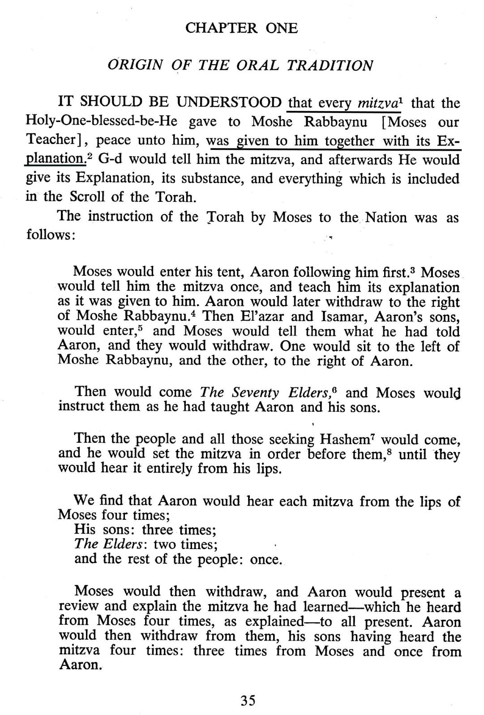
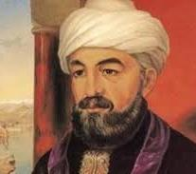
Rambam / Maimonides
Introduction to the Mishneh
הקדמות לפירוש המשנה
Leviticus 26:46
“These are the decrees, the ordinances, and the teachings that Hashem gave, between Himself and The Children of Israel, at Mount Sinai, through Moses.”
אֵלֶּה הַחֻקִּים וְהַמִּשְׁפָּטִים, וְהַתּוֹרֹת, אֲשֶׁר נָתַן יְהוָה, בֵּינוֹ וּבֵין בְּנֵי יִשְׂרָאֵל--בְּהַר סִינַי, בְּיַד-מֹשֶׁה.

Slide 18
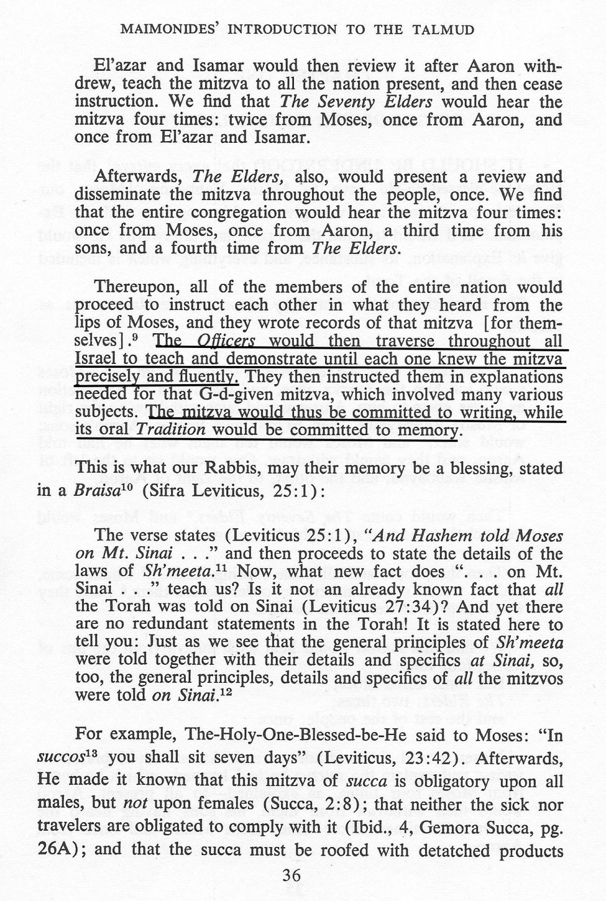
Rambam / Maimonides
Introduction to the Mishneh
הקדמות לפירוש המשנה

Slide 19
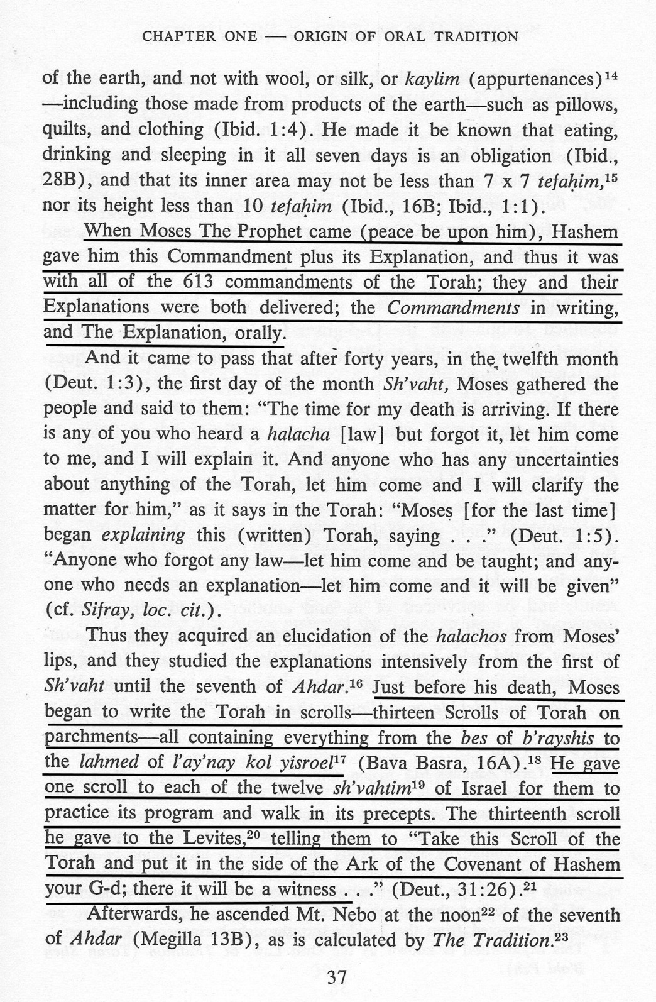
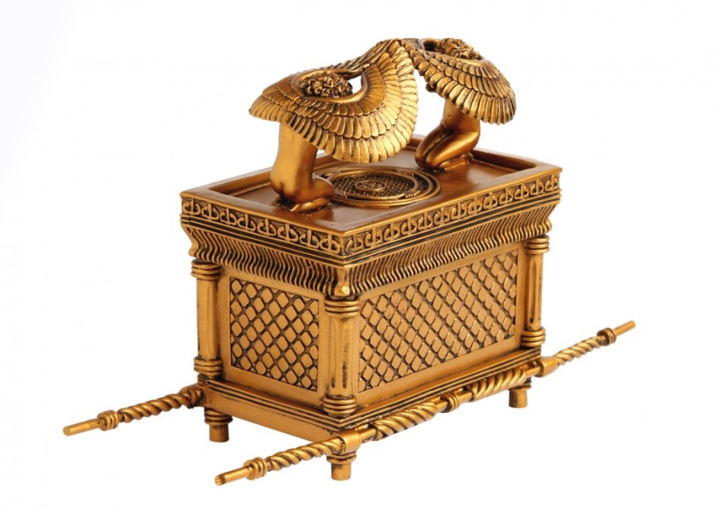
Rambam / Maimonides
Introduction to the Mishneh
הקדמות לפירוש המשנה

Slide 20
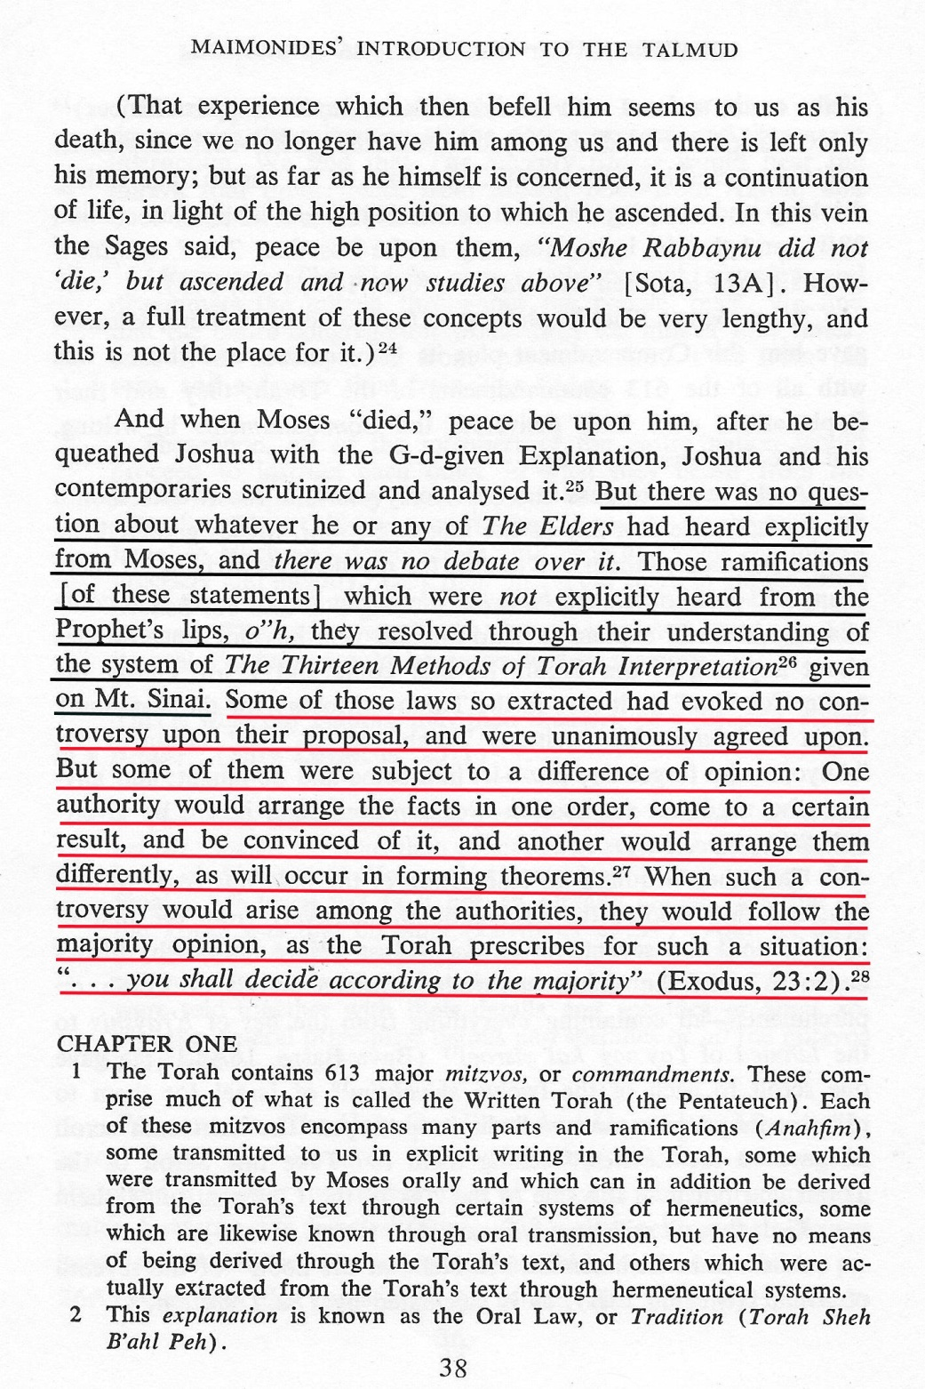
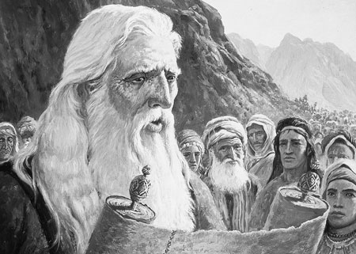
According to the Rambam, Moshe
received the description of each and
every commandment, as well as the
13 Hermeneutical Principals which is the
process of Scriptural Interpretation.
Through them it is possible to derive all
the laws from the Written Torah.
Additionally, Moshe was given the
Commandments verbally, including all the detail of the written Torah (which was given to Moshe during the 40 years in the desert.
Any law that could be lost, the Sages were able to derive out of the written Torah using the 13 Hermeneutical Principals.

Slide 21
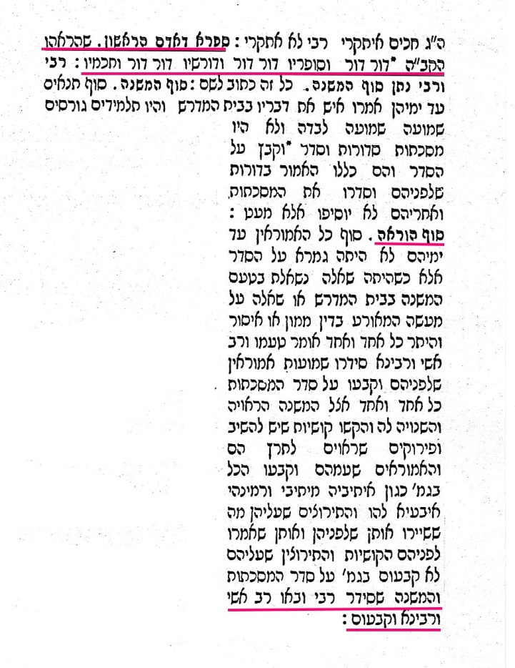
Gemorah Baba Metzia 86a
Discusses the BOOK OF ADAM HARISHON
which mentions the sealing of the Talmud by
Ravina and Rav Ashi.
NO MORE POWER TO USE THE 13 HERMENEUTICAL PRINCIPALS
Rashi: Hashem showed Adam each and every generation,
What will happen and the wisdom that each perceive. Rebbi will Codify/Seal the Mishna and Rav Ashi and Ravina the Talmud.

Slide 22
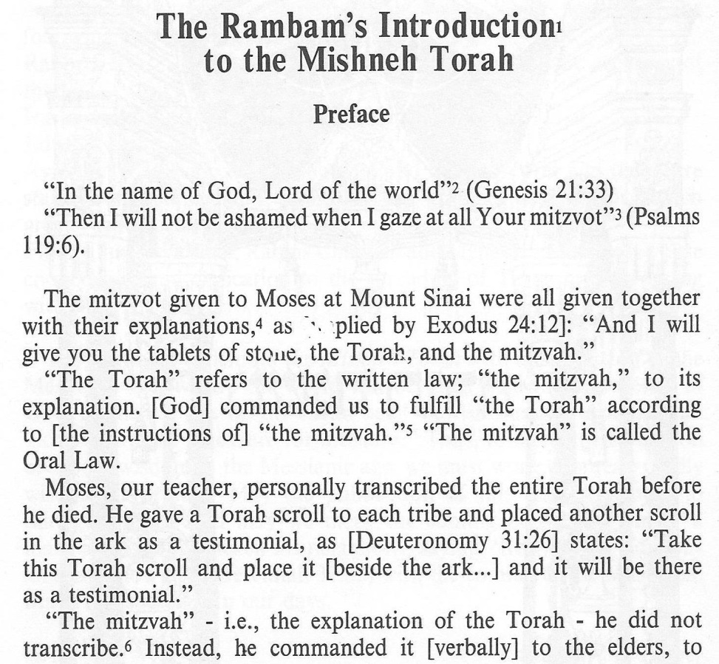
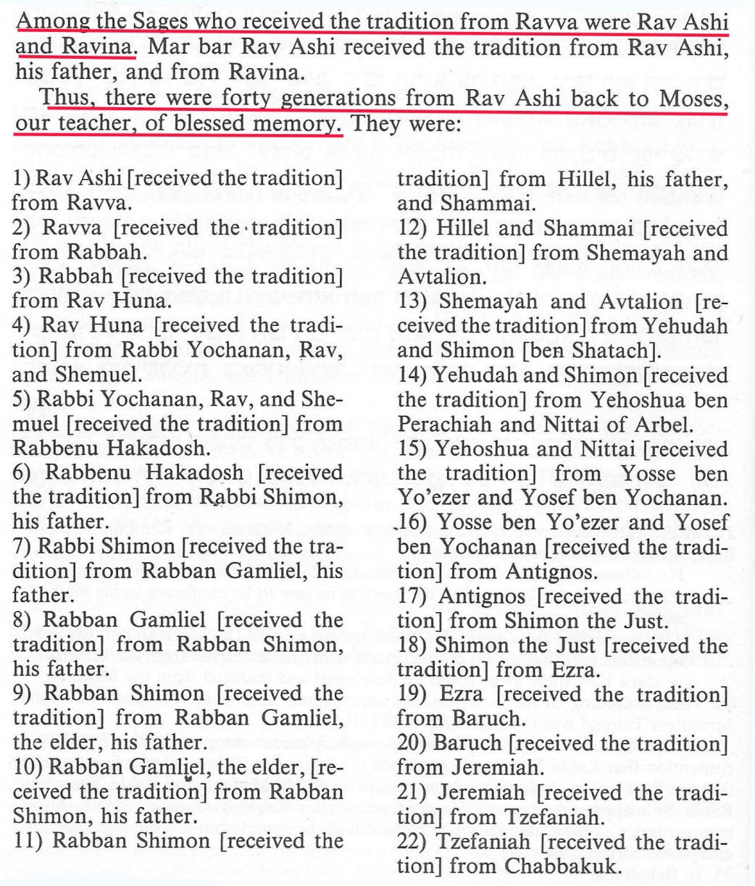

Slide 23
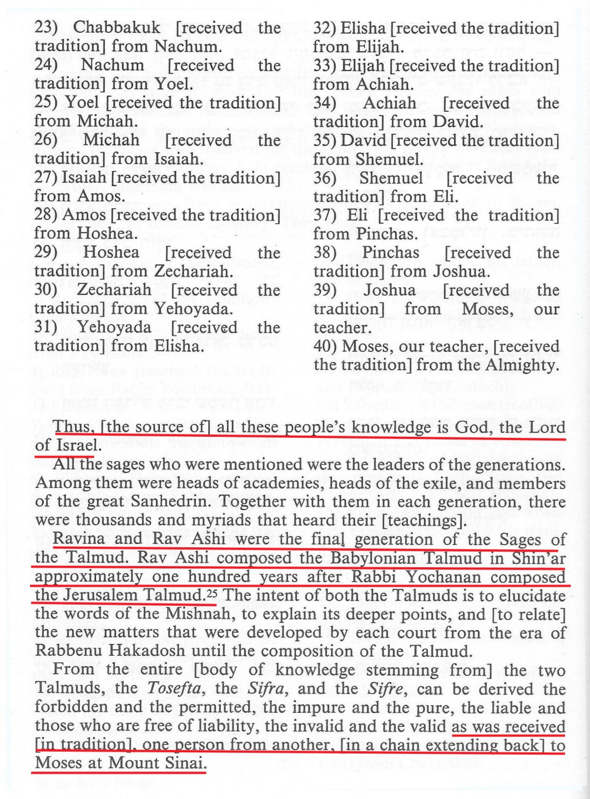
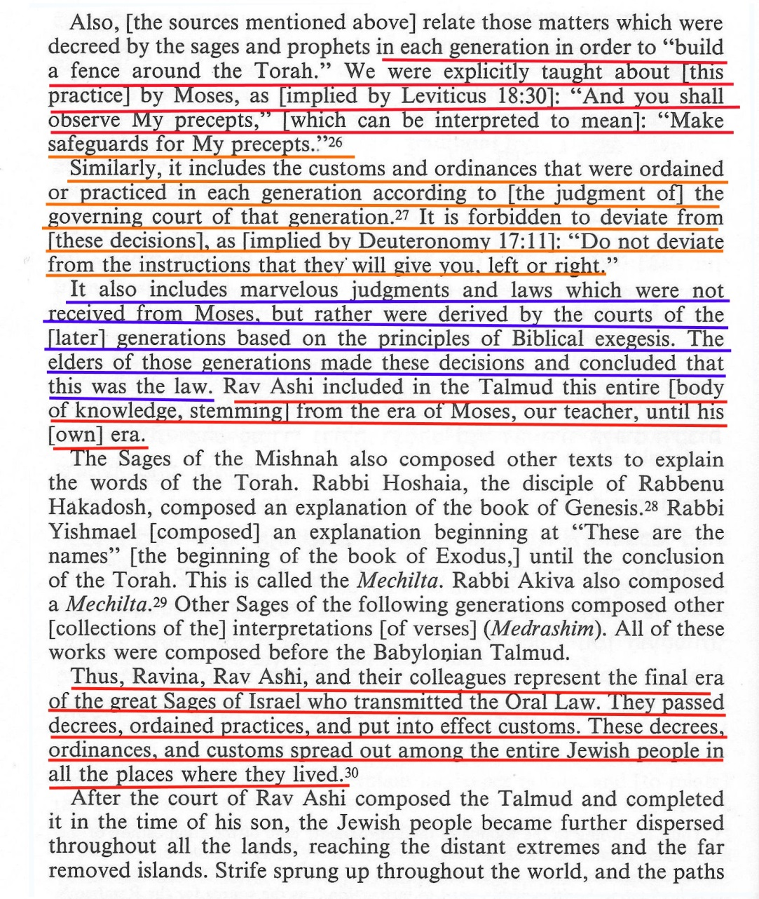

Slide 24
Rambam Positive Mitzvah 11
To Teach Wisdom of Torah and to Study it (Talmud Torah)
As it is written (Deut. 6:7) “And you shall teach them to your sons”, וְשִׁנַּנְתָּם לְבָנֶיךָ Our sages say, there are your disciples. And it is common to find disciples referred to as your sons, as in (II Kings 2:3) “And the sons of the prophets went out” וַיֵּצְאוּ בְנֵי-הַנְּבִיאִים ……
Rambam Positive Mitzvah 6
To mingle with Torah scholars, to associate with them, to sit constantly among them, and to participate with them wherever possible. – in eating and drinking, in buying and selling, so that we thereby come to emulate their deeds and to subscribe to the true ideas contained in their words, as the Exalted One has said, (Deut.11:22): “And to cleave to Him” וּלְדָבְקָה-בוֹ again (Deut.10:20) “And to Him you shall cleave” וּבוֹ תִדְבָּק … Is it possible for one to cling to the Shechina? Isn't it written (Deut. 4:24) For the Lord your God is a consuming fire? כִּי יְהוָה אֱלֹהֶיךָ, אֵשׁ אֹכְלָה הוּא: אֵל, קַנָּא Do business with them and marry your daughters to them….
Rambam Negative Mitzvah 312
The exhortation against differing from the transmitters of the tradition, may peace be upon them, and turning away from all that they command us in respect to Torah enactments (Deut .17:11)“According to the teaching that they shall teach you and according to the judgment which they will say to you, shall you do; you shall not deviate from the word that they will tell you, right or left.” עַל-פִּי הַתּוֹרָה אֲשֶׁר יוֹרוּךָ, וְעַל-הַמִּשְׁפָּט אֲשֶׁר-יֹאמְרוּ לְךָ--תַּעֲשֶׂה: לֹא תָסוּר, מִן-הַדָּבָר אֲשֶׁר-יַגִּידוּ לְךָ--יָמִין וּשְׂמֹאל.

Slide 25
SUMMERY
In Conclusion:
That National Unity is of upmost importance for receiving the Torah
Character Development and Humility are necessary traits towards receiving the Torah
We have a better understanding of what Torah is. The same Torah we have Today is the same Torah received at Sinai for all the Tribes

Slide 26
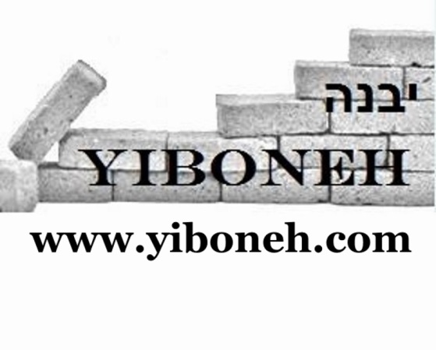
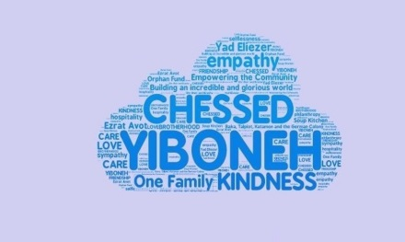
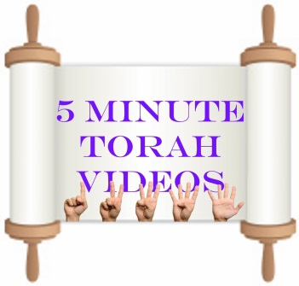
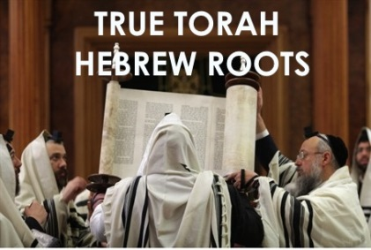
Stay in touch.
Aarondovid@yiboneh.com
GOT QUESTIONS?
Want to Learn On-Line?
In Person? One on One?
Visit your community?

